Slide 1
Genetic algorithms
Travelling salesman problem

Slide 2
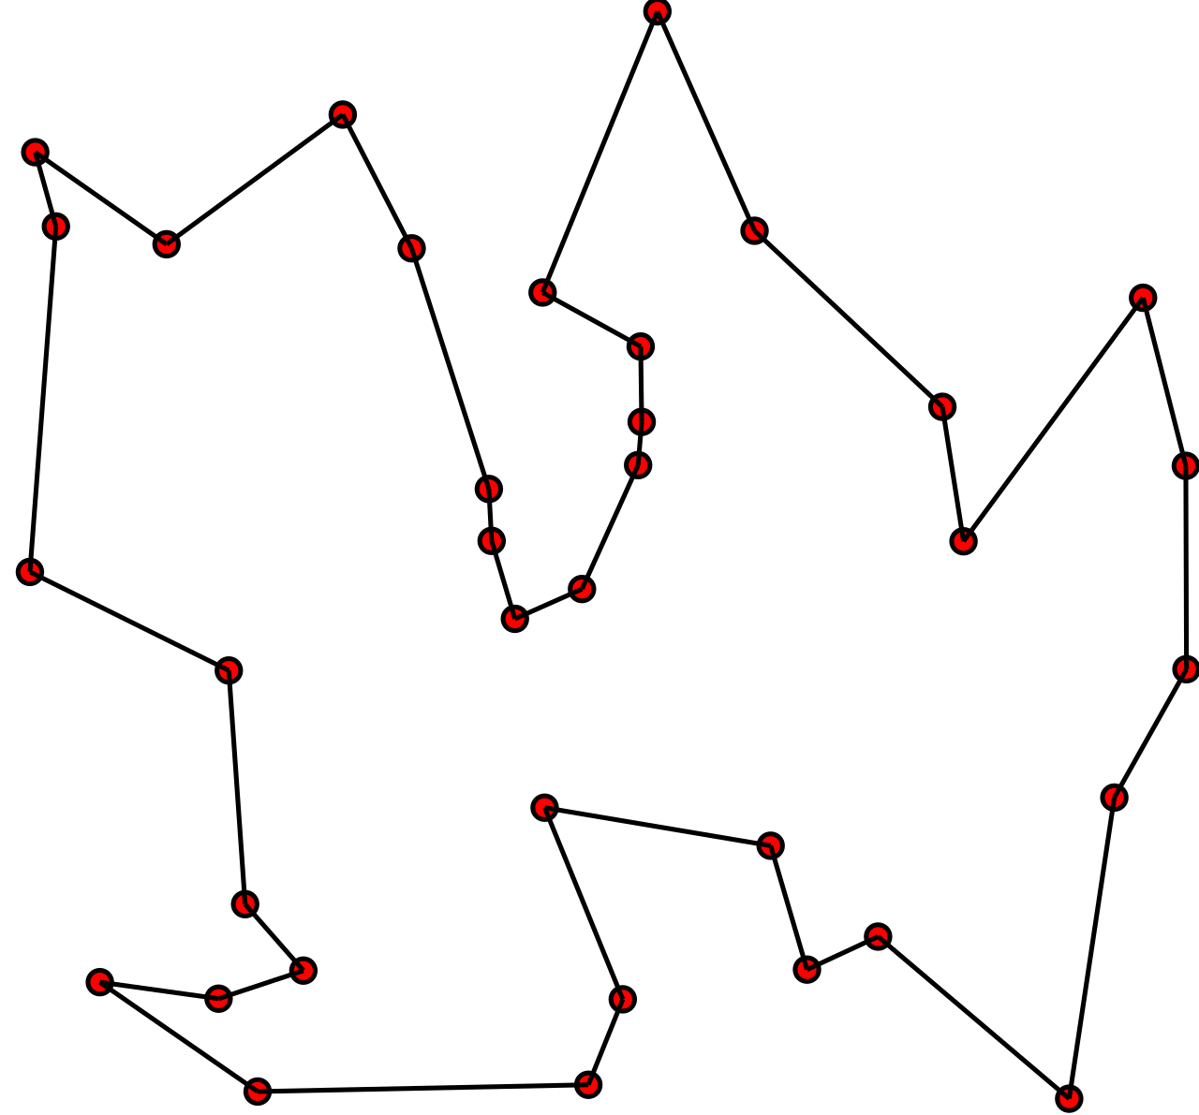
The idea of the problem

Slide 3
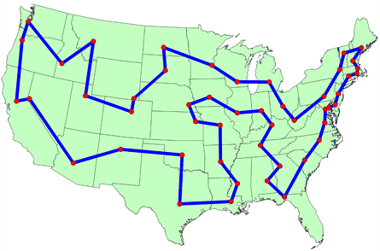
The idea of the problem

Slide 4

What is complexity of brute force approach?

Slide 5
What is complexity of brute force approach?
O(n!)

Slide 6
History of the problem
In an 1832 manual for traveling salesman, which included example tours of 45 German cities but gave no mathematical consideration.
W. R. Hamilton and Thomas Kirkman devised mathematical formulations of the problem in the 1800s. It is believed that the general form was first studied by Karl Menger in Vienna and Harvard in the 1930s.
Hassler Whitney, who was working on his Ph.D. research at Harvard when Menger was a visiting lecturer, is believed to have posed the problem of finding the shortest route between the 48 states of the United States during either his 1931-1932 or 1934 seminar talks.
The problem became increasingly popular in the 1950s and 1960s. Notably, George Dantzig, Delber R. Fulkerson, and Selmer M. Johnson at the RAND Corporation in Santa Monica, California solved the 48 state problem by formulating it as a linear programming problem.
In the early 1970s, the concept of P vs. NP problems created buzz in the theoretical computer science community. In 1972, Richard Karp demonstrated that the Hamiltonian cycle problem was NP-complete, implying that the traveling salesman problem was NP-hard.
Increasingly sophisticated codes led to rapid increases in the sizes of the traveling salesman problems solved. Dantzig, Fulkerson, and Johnson had solved a 48 city instance of the problem in 1954.
Martin Grötechel more than doubled this 23 years later, solving a 120 city instance in 1977.
Enoch Crowder and Manfred W. Padberg again more than doubled this in just 3 years, with a 318 city solution.
In 1987, rapid improvements were made, culminating in a 2,392 city solution by Padberg and Giovanni Rinaldi. In the following two decades, David L. Appelgate, Robert E. Bixby, Vasek Chvátal, & William J. Cook led the cutting edge, solving a 7,397 city instance in 1994 up to the current largest solved problem of 24,978 cities in 2004.

Slide 7
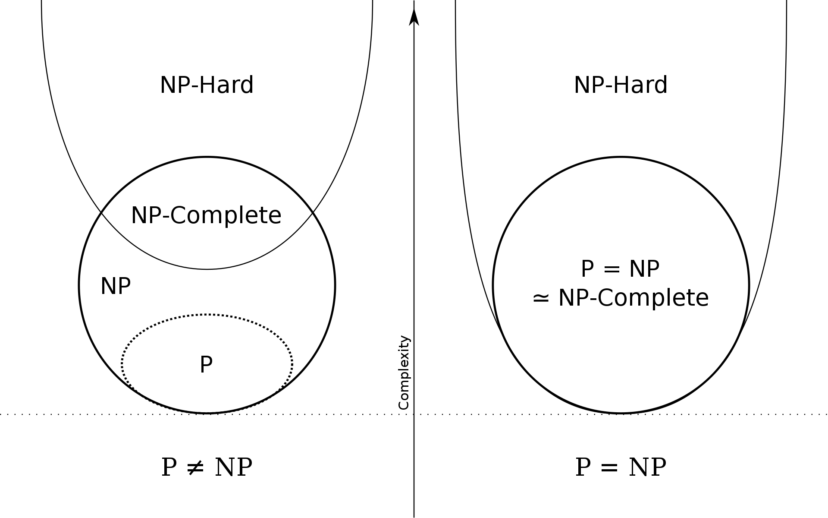
P VS NP

Slide 8
Greedy algorithms

Slide 9
Greedy algorithms

Slide 10
What can be greedy algorithm in TSP?

Slide 11
What can be greedy algorithm in TSP?

Slide 12
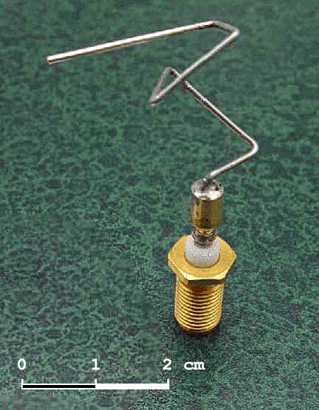
Genetic algorithms

Slide 13
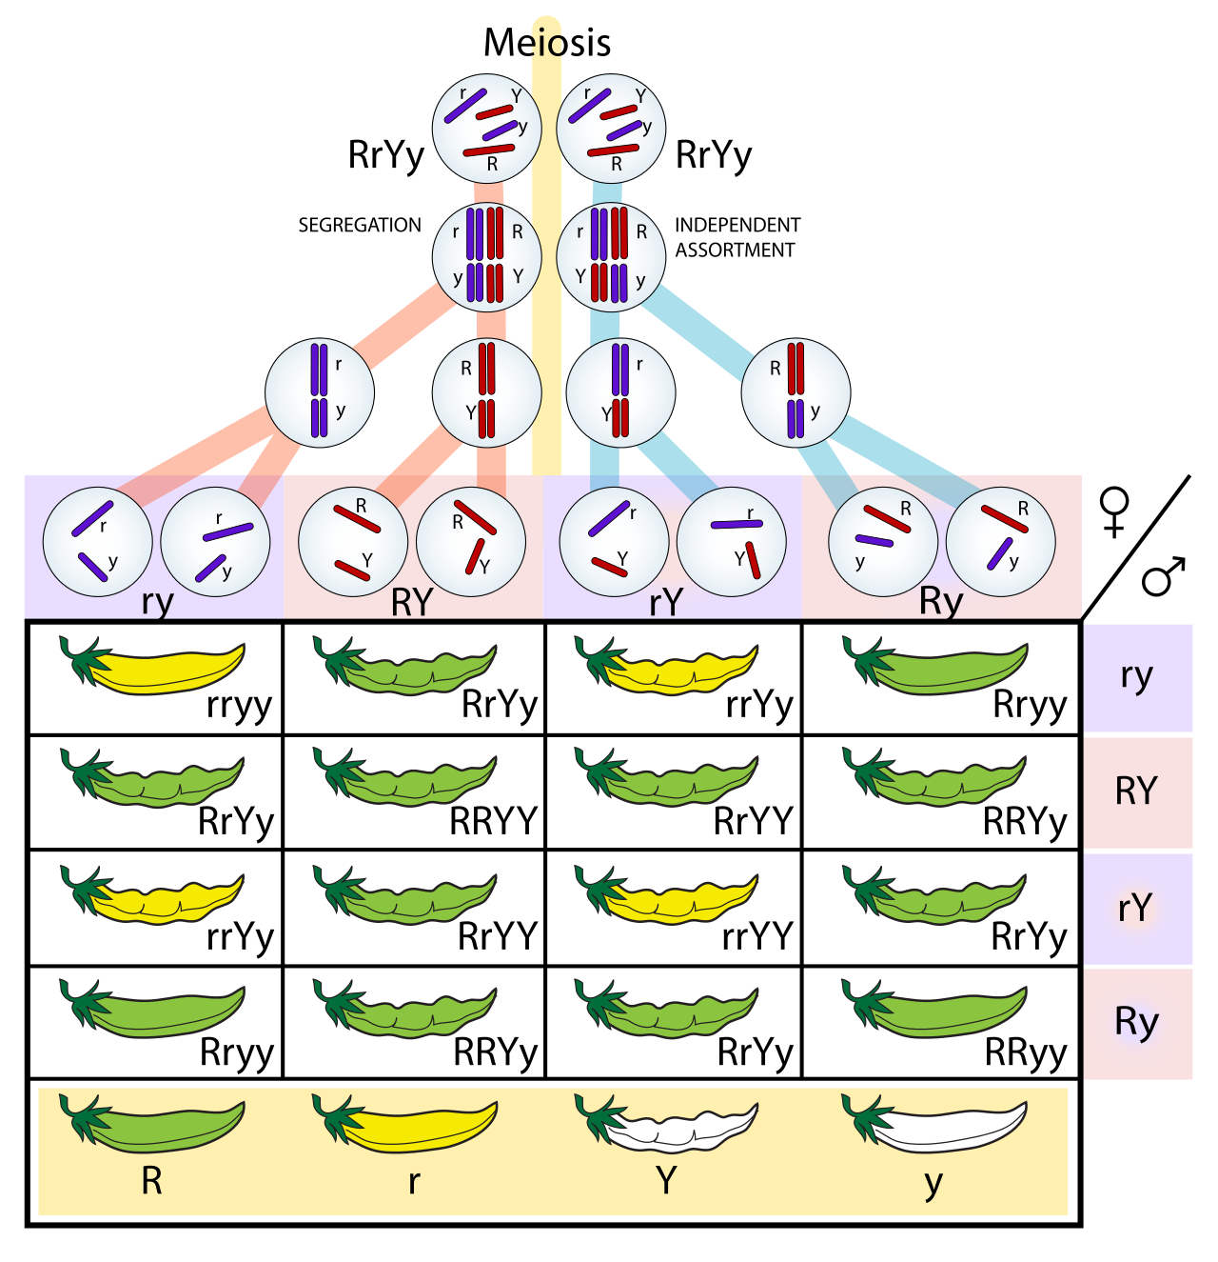
Genetic algorithms

Slide 14
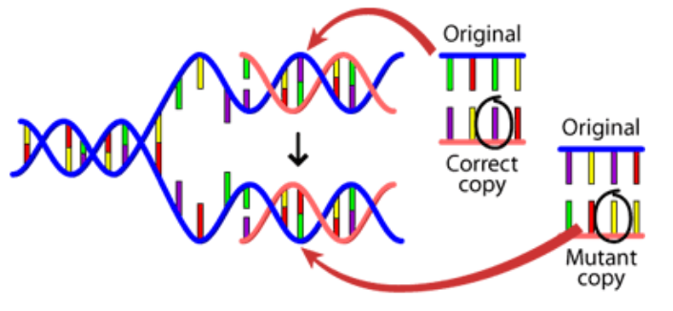
Genetic algorithms

Slide 15
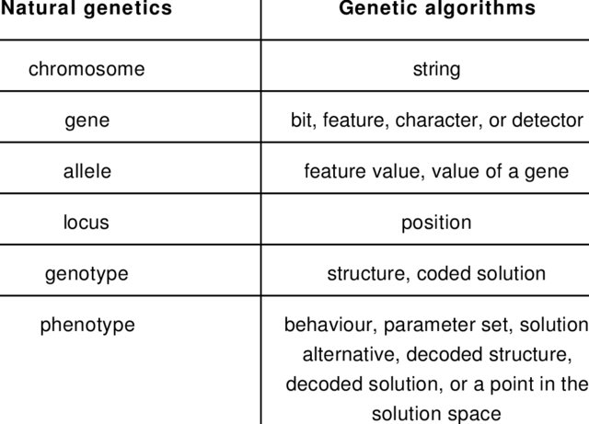
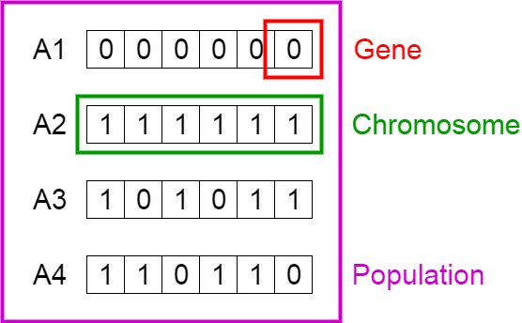
Genetic algorithms

Slide 16
Phases of genetic algorithms
Initial population
Fitness function
Selection
Crossover
Mutation

Slide 17
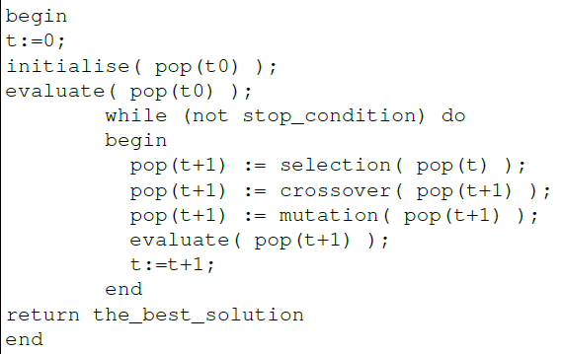
Pseudocode

Slide 18
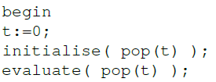
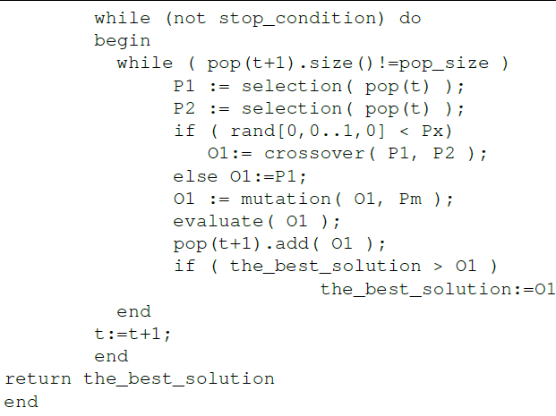
Pseudocode

Slide 19
Phases of genetic algorithms
Initial population
Fitness function
Selection
Crossover
Mutation

Slide 20
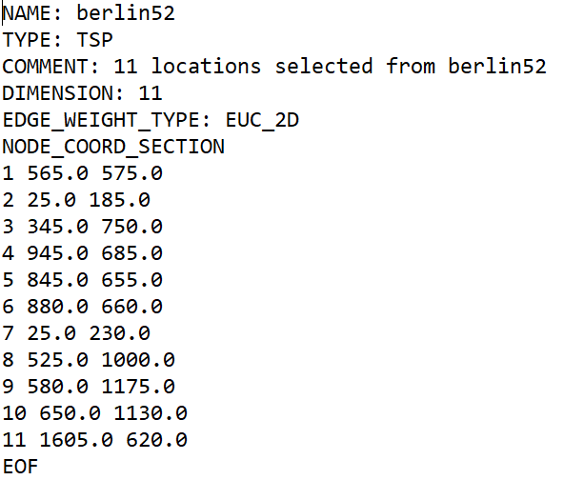
How to apply GA to real problem like TSP?

Slide 21
How to describe individual?

Slide 22
What is initial population?

Slide 23
Phases of genetic algorithms
Initial population
Fitness function
Selection
Crossover
Mutation

Slide 24
What is fitness function?

Slide 25
Phases of genetic algorithms
Initial population
Fitness function
Selection
Crossover
Mutation

Slide 26
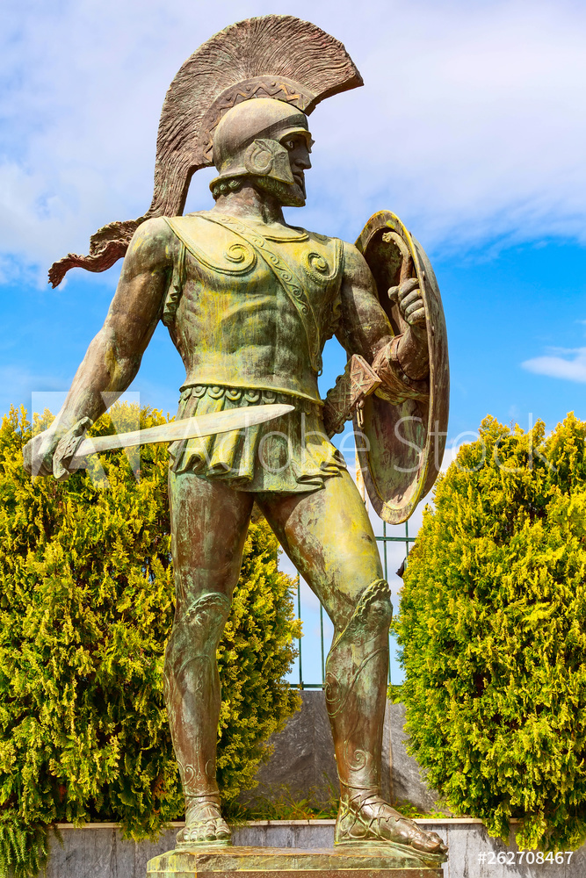
What is selection stage?

Slide 27
Selection stage
Tournamemt
Elite
Roullette

Slide 28
Phases of genetic algorithms
Initial population
Fitness function
Selection
Crossover
Mutation

Slide 29
What is crossover stage?

Slide 30

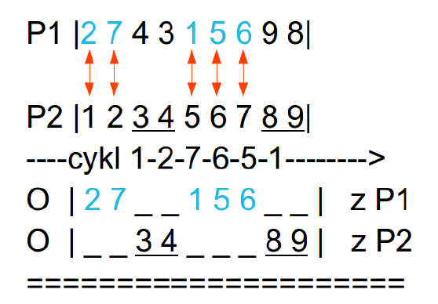
Crossovers method
Ordered crossover (OC)
Partially matched-crossover (PMX)
Cyce crossover (CX)

Slide 31
https://www.hindawi.com/journals/cin/2017/7430125/

Slide 32
Phases of genetic algorithms
Initial population
Fitness function
Selection
Crossover
Mutation

Slide 33
Why we need mutation?

Slide 34
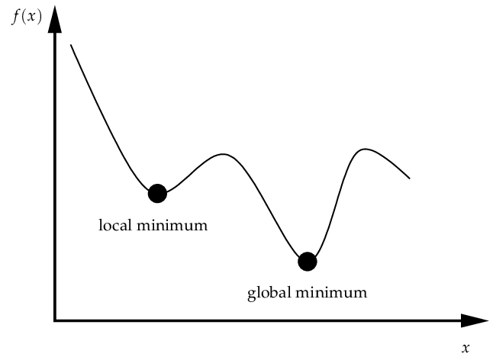
Why we need mutation?

Slide 35

How we can apply mutation?

